Slide 1
Arrays and Collections

Slide 2
Contents
Arrays
Kotlin collections
Functional programming techniques

Slide 3
1. Arrays
Overview of arrays
Creating an array
Creating an array via an initializer function
Indexing into an array
Iterating over an array
Array capabilities
Primitive arrays

Slide 4
Overview of Arrays
Kotlin defines the Array<T> class
Homogenous fixed-size sequence, analogous to Java arrays
Characteristics of Array<T>
Has a size property, to get the size
Has get() and set() functions, to support indexing [i]
Has iterator() functions, to support iteration
We discuss the Array<T> class on the coming slides
See DemoArrays.kt for code demos
class Array<T> private constructor() {
val size: Int
operator fun get(index: Int): T
operator fun set(index: Int, value: T): Unit
operator fun iterator(): Iterator<T>
…
}

Slide 5
Creating an Array
Kotlin has some standard functions you can use to create an array…
To create an empty array:
To create an array from a series of values:
To create an array of a specific size, with nulls initially:
val strArray = emptyArray<String>()
val strArray = arrayOf("Norway", "Sweden", "Denmark", "Finland")
val strArray = arrayOfNulls<String>(4)

Slide 6
Creating an Array via an Initializer Function
The Array<T> class has a constructor that allows you to initialize items to specific values
param 1 - Size of array
param 2 - Initializer function, to initialize an item
Example:
val strArray = Array(5) { i -> "Hello from string $i" }

Slide 7
Indexing into an Array
To index into an array, use[i]
Under the covers, Kotlin calls get() and set()
An out-of-bounds index causes IndexOutOfBoundsException
val item = anArray[anIndex]
anArray[anIndex] = newValue

Slide 8
Iterating over an Array
You can iterate over an array via a regular for loop
Alternatively, call forEach() on the array
Pass in a function to apply to each element
for (item in anArray) {
println(item)
}
anArray.forEach {
println(it)
}

Slide 9
Array Capabilities
Array<T> has many functions (members and extensions) to manipulate array items
Example of some of these functions:
val res = anArray.contains(anItem)
val distinctArray = anArray.distinct()
val arrayExceptFirstTwo = anArray.drop(2)
val arrayExceptLastTwo = anArray.dropLast(2)
val safeGetResult = anArray.getOrElse(42, { i -> "Surrogate for element at $i" })
anArray.sort()
val indexOfXXX = anArray.binarySearch("XXX")

Slide 10
Primitive Arrays
Kotlin has specialized array classes for primitive types
Avoid the overhead of boxing/unboxing
Primitive array classes:
ByteArray, ShortArray, IntArray, LongArray
UByteArray, UShortArray, UIntArray, ULongArray
FloatArray, DoubleArray
BooleanArray
CharArray
Example usage:
val intArray = intArrayOf(0, 42, 247, 180, 2011)
val doubleArray = DoubleArray(5) { i -> Math.sqrt(i.toDouble()) }

Slide 11
2. Kotlin Collections
Overview
Kotlin collection hierarchy
Creating collections
Read-only collections are covariant
Mutable collections are not covariant
For further information…

Slide 12
Overview of Collections
Kotlin has an extensive collection API
Lists, maps, sets
You are advised to use this rather than the Java collection API
More amenable to Kotlin techniques and FP
The Kotlin collection API is divided into two parts
Immutable collections (non modifiable) - recommended!
Mutable collections (modifiable)
All the Kotlin collection classes are generic
val people: List<String> = …

Slide 13
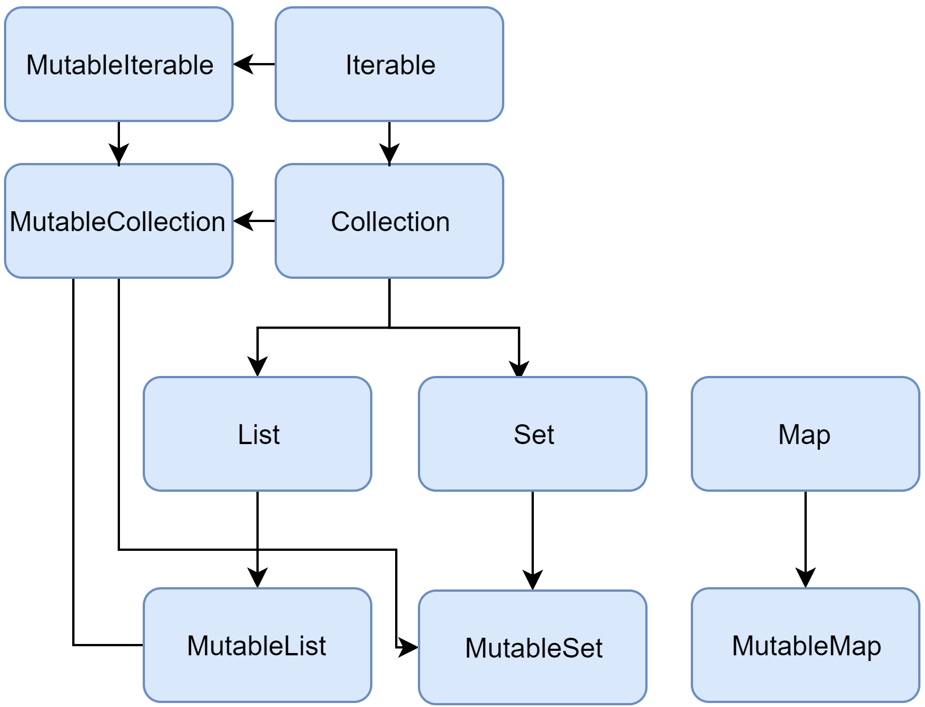
Kotlin Collection Hierarchy
For each type of collection:
There's a read-only interface
There's a sub-interface that adds mutable methods
This is a screenshot from Kotlin docs
The inheritance arrows point the wrong way - doh!

Slide 14
Creating Collections
Here's a quick example to show how to create and use some simple collections
fun demoCollections() {
val books = listOf("Matthew", "Mark", "Luke", "John")
books.forEach{println(it)}
val ukNations = mutableListOf("England", "Scotland", "Wales", "N Ireland")
ukNations.remove("Scotland")
ukNations.add("USA")
ukNations -= "N Ireland"
ukNations += "Singapore"
ukNations.forEach{println(it)}
val diallingCodes = mapOf(Pair("UK", "+44"), Pair("Norway", "+47"), …)
println(diallingCodes.size)
val decentWelshTeams = setOf("Swansea", "Newport", "Wrexham", "Swansea")
println(decentWelshTeams.size)
}
DemoCollections.kt

Slide 15
Read-only Collections are Covariant
Read-only collections are covariant
So the Liskov Substitution Principle applies
fun demoReadOnlyCollectionsAreCovariant() {
// Read-only collections are covariant, so Liskov applies.
val alist1 : List<A> = listOf<A>(A(100), A(200), A(300))
val alist2 : List<A> = listOf<B>(B(400), B(500), B(600))
val alist3 : List<A> = listOf<C>(C(700), C(800), C(900))
}
DemoCollections.kt

Slide 16
Mutable Collections are not Covariant
Mutable collections are not covariant
So the Liskov Substitution Principle doesn't apply
fun demoMutableCollectionsAreNotCovariant() {
// Mutable collections are not covariant, so Liskov doesn't apply.
// This is OK...
val alist1 : MutableList<A> = mutableListOf<A>()
alist1.add(A(100))
alist1.add(B(200))
alist1.add(C(300))
display(alist1)
// This is not OK...
// val alist2 : MutableList<A> = mutableListOf<B>()
// alist2.add(A(400))
// alist2.add(B(500))
// alist2.add(C(600))
// This is not OK either...
// val alist3 : MutableList<A> = mutableListOf<C>()
// alist3.add(A(700))
// alist3.add(B(800))
// alist3.add(C(900))
}
DemoCollections.kt

Slide 17
For Further Information…
The Kotlin collections are extensive and intuitive
Offer very similar capabilities to their Java counterparts
So we don't need to drill into the minutiae here
For full details, see Kotlin docs starting here:
https://kotlinlang.org/api/latest/jvm/stdlib/kotlin.collections/

Slide 18
3. Functional Programming Techniques
Overview
Performing an operation on each element
Filtering elements
Mapping elements
Mapping elements via flatMap
Folding elements
Reducing elements
Grouping elements

Slide 19
Overview
Kotlin collections inherit from the Iterable interface
Iterable has many methods that support functional programming techniques on collections
E.g. forEach, filter, map, fold, groupBy, etc.
We'll explore some of the main features in this section

Slide 20
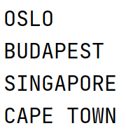
Performing an Operation on Each Element
forEach applies the specified operation to each element in an iterable
Here's the definition of forEach:
Example usage:
inline fun <T> Iterable<T>.forEach(action: (T) -> Unit)
fun demoForEach() {
val cities = listOf("Oslo", "Budapest", "Singapore", "Cape Town")
cities.forEach{
println(it.uppercase())
}
}
DemoFP.kt

Slide 21
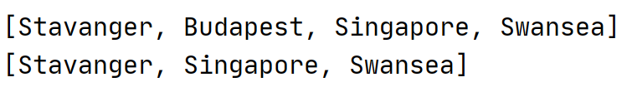
Filtering Elements
filter applies a predicate to elements in an iterable
Returns a list of matching elements
Example usage:
inline fun <T> Iterable<T>.filter(
predicate: (T) -> Boolean
): List<T>
fun demoFilter() {
val cities = listOf("Stavanger", "Budapest", "Singapore", "Swansea")
println(cities)
val citiesStartingWithS = cities.filter{it.startsWith("S")}
println(citiesStartingWithS)
}
DemoFP.kt

Slide 22

Mapping Elements
map transforms elements in an iterable
Returns a list (of a potentially different element type)
Example usage:
inline fun <T, R> Iterable<T>.map(
transform: (T) -> R
): List<R>
fun demoMap() {
data class City(val name: String, val population: ULong)
val cities = listOf( City("Stavanger", 121000UL),
City("Budapest", 1800000UL),
City("Singapore", 5600000UL) )
val pops = cities.map{it.population}
println(pops)
}
DemoFP.kt

Slide 23
Mapping Elements via flatMap
flatMap is similar to Map, except:
flatMap flattens multi-dim iterable into a single-dim list
Example usage:
inline fun <T, R> Iterable<T>.flatMap(
transform: (T) -> Iterable<R>
): List<R>
fun demoFlatMap() {
data class City(val name: String, val landmarks: List<String>)
val cities = listOf(City("Singapore", listOf("Merlion", "Sentosa")),
City("Budapest", listOf("Castle", "Chain Bridge")),
City("Stavanger", listOf("Priekestolen", "Møllebukta")))
val landmarks = cities.map{it.landmarks}
val landmarksFlatMap = cities.flatMap{it.landmarks}
println(landmarks)
println(landmarksFlatMap)
}
DemoFP.kt

Slide 24
Folding Elements
fold combines all the elements in an iterable into a single result, going from left to right
Example usage:
a is accumulated value from previous step (initially "RESULT:")
c is current element in cities list
inline fun <T, R> Iterable<T>.fold(
initial: R,
operation: (acc: R, T) -> R
): R
fun demoFold() {
val cities = listOf("Stavanger", "Budapest", "Singapore")
val str = cities.fold("RESULT:") { a, c -> "$a $c" }
println(str)
}
DemoFP.kt

Slide 25
Reducing Elements
reduce is similar to fold, except it doesn't provide an initial value for the accumulator
Instead it passes elements 0 and 1 into the operator initially
Example usage:
inline fun <S, T : S> Iterable<T>.reduce(
operation: (acc: S, T) -> S
): S
fun demoReduce() {
val cities = listOf("Stavanger", "Budapest", "Singapore")
val str = cities.reduce{ a, c -> "$a $c" }
println(str)
}
DemoFP.ktc

Slide 26
Grouping Elements
groupBy groups elements with same group-by value
The result is a Map
Associates each unique group to the list of items in that group
Example usage:
inline fun <T, K> Iterable<T>.groupBy(
keySelector: (T) -> K
): Map<K, List<T>>
fun demoGroupBy() {
data class City(val name: String, val pop: Long, val country: String)
val cities = listOf(City("Oslo", 580000, "Norway"),
City("Cape Town", 3433441, "SA"),
City("Durban", 3120282, "SA"),
City("Bergen", 213585, "Norway"),
City("Trondheim", 147139, "Norway"),
City("Joburg", 2026469, "SA"))
val groupedCities = cities.groupBy{it.country}
println(groupedCities)
}
DemoFP.ktc

Slide 27
Any Questions?

